Slide 1
Fourier

Slide 2
Fourier Analysis

Slide 3
Fourier Analysis
When we analyse a function using Fourier methods, the function is decomposed into its frequency components.
This analysis is used in signal processing, filtering.

Slide 4

Fourier Analysis
Consider the two waveforms above, where the first waveform is made up of only one pure wave.
The second waveform (which could be from a steel pan or speech) is made up of one fundamental (pure) wave, with many other waves of higher frequency.

Slide 5



Fourier Analysis
If we consider the Fourier of the waveforms we find the following:
Intensity
Intensity
frequency
frequency

Slide 6
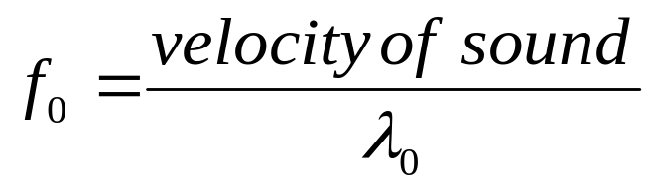
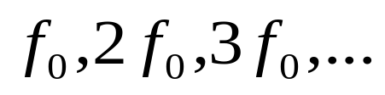
Fourier Analysis
Where is called the fundamental frequency.
are the harmonics.

Slide 7
Fourier Series

Slide 8
Fourier Series
The Fourier series is used to represent other functions.
This is achieved by a series of sines and cosines within the given interval, which can be used as an approximation to the function.

Slide 9
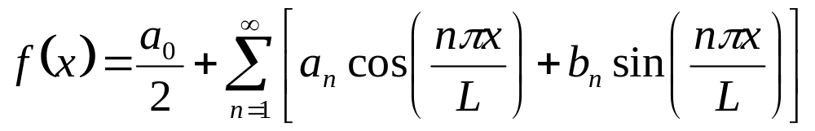
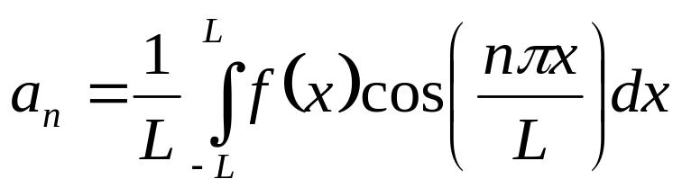
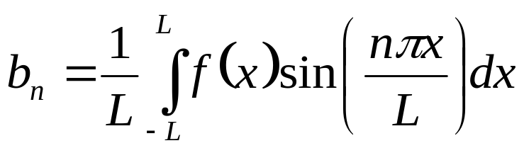
Fourier Series
The general formula for the fourier series:
Where the coefficients are given by,

Slide 10
Fourier Series
Writing a Fourier series means finding the the coefficients a_{n}, b_{n}.
Consider the example.
Write the function f(x)=x as a Fourier series on the interval –Π,Π.

Slide 11
Fourier Series
The Fourier series is used for approximating or analysing periodic functions.

Slide 12
Fourier Transform

Slide 13
Fourier Transform
While a Fourier is useful for periodic functions, the Fourier transform or integral is used for non-periodic functions.

Slide 14
Fourier Transform
While a Fourier is useful for periodic functions, the Fourier transform or integral is used for non-periodic functions.

Slide 15

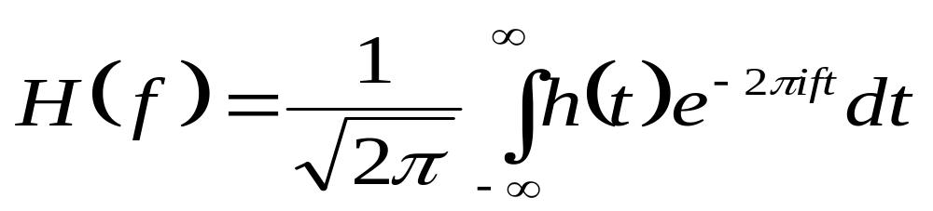
Fourier Transform
The Fourier transform of a function is,
For compactness we use the complex exponent function.
The Fourier transform transforms from the t domain to the f domain.

Slide 16
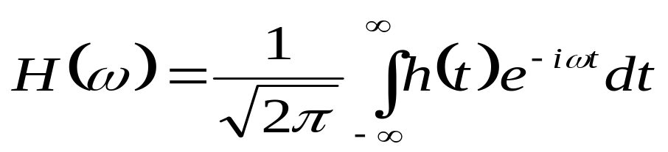
Fourier Transform
By convention time t is used as the functions variable and frequency as the transform variable.
However these can be reversed or variable such as position and momentum used. eg. position to frequency.

Slide 17
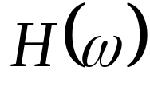

Fourier Transform
A plot of the square of the modulus of the Fourier transform ( vs ) is called the power spectrum.
It gives the amount the frequency contributes to the waveform.

Slide 18
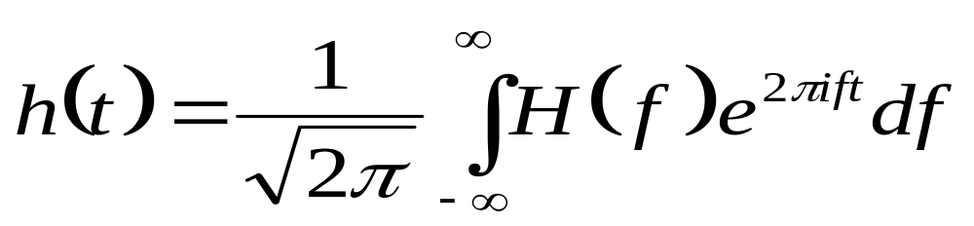
Fourier Transform
The inverse Fourier is,

Slide 19
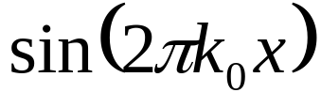
Fourier Transform
Example: Fourier transform of .

Slide 20
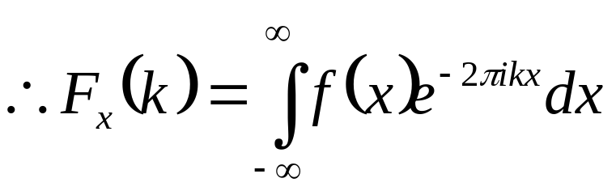
Fourier Transform
Example: Fourier transform of .

Slide 21
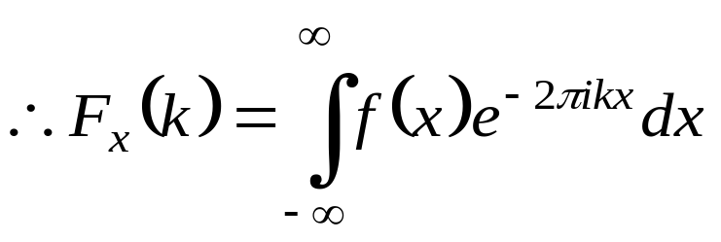
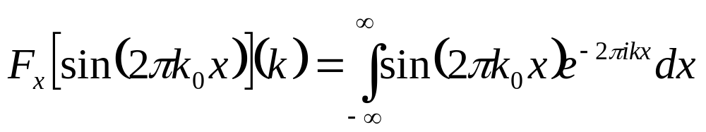
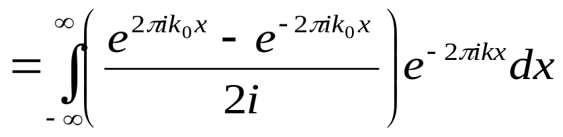
Fourier Transform
Example: Fourier transform of .

Slide 22

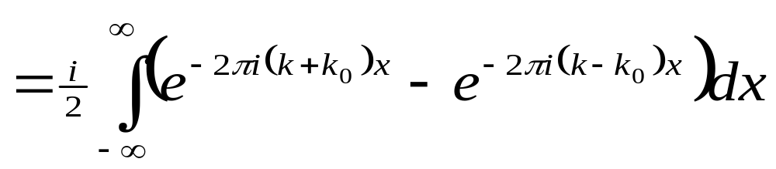
Fourier Transform
Example: Fourier transform of .

Slide 23
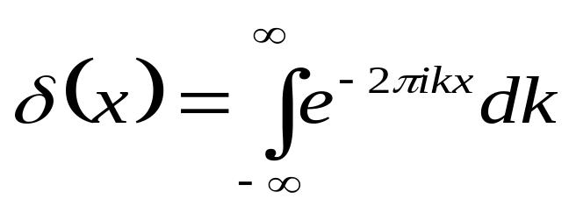



Fourier Transform
However the delta function is,

